Slide 1
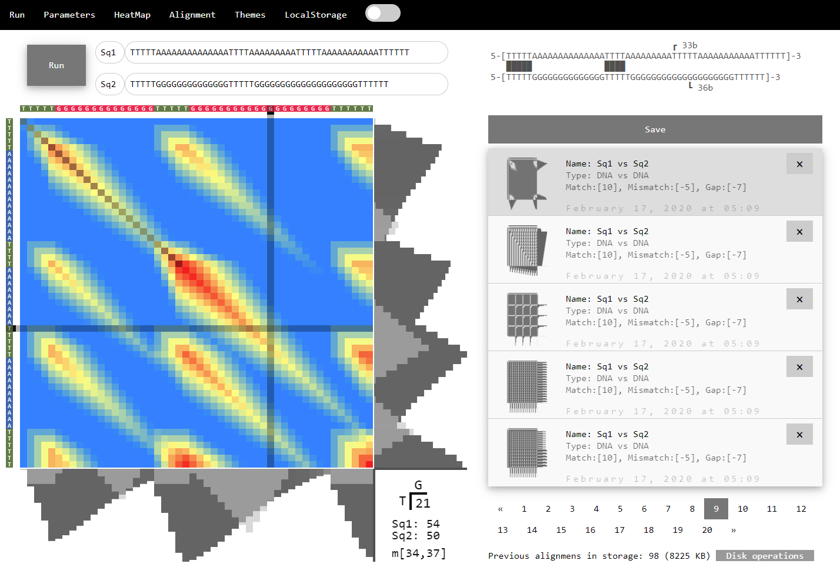
(b)
(c)
(a)
(d)

Slide 2


BioJupiter interface and functionalities
BioJupiter interface and functionalities. (a-c) The application interface. (a) main heatmap, (b) the main alignment result, (c) the local storage browser and disk operations. (d) graphic themes.
Cite this work as:
Paul A. Gagniuc. Algorithms in Bioinformatics: Theory and Implementation. John Wiley & Sons, Hoboken, NJ, USA, 2021, ISBN: 9781119697961.

